Slide 2
Human society cannot function without ___________, as they provide normative orientations about what is good and what is bad.
They regulate .... what is desired in terms of a vision as well as in terms of the journey we take, the sacrifices we make and the actions we avoid or take.

Slide 3




Values in the context of Decision Making

Slide 4
# | People | Match The Following | No | Most Important Value
A | Aamir Khan |  | 1 | Ahimsa
B | Abraham Lincoln |  | 2 | Community Self-Respect
C | Amitabh Bachchan |  | 3 | Compassion
D | APJ Abdul Kalam |  | 4 | Courage
E | Bhimrao Ramji Ambedkar |  | 5 | Equality of Man
F | Biju Patnaik |  | 6 | Intellectual Socialism
G | E Sreedharan |  | 7 | Justice (& Fairness)
H | Mahatma Gandhi |  | 8 | Nishkama Karma
I | Mother Teresa |  | 9 | Perseverance
J | Nelson Mandela |  | 10 | Professional Aspiration
K | Sarojini Naidu |  | 11 | Social Engagement
L | Shashi Tharoor |  | 12 | Social Justice
M | Sourav Ganguly |  | 13 | Vision
N | Subhash Chandra Bose |  | 14 | Womenhood

Slide 5
People | Key Value
Aamir Khan | Social Engagement
Abraham Lincoln | Equality of Man
Amitabh Bachchan | Professional Aspiration
APJ Abdul Kalam | Vision
B R Ambedkar | Social Justice
E Sreedharan | Nishkama Karma
Mahatma Gandhi | Ahimsa
Mother Teresa | Compassion
Nelson Mandela | Justice (& Fairness)
Sarojini Naidu | Womenhood
Shashi Tharoor | Intellectual Socialism
Sourav Ganguly | Perseverance
Subhash Chandra Bose | Courage
Biju Patnaik | Community Self-Respect

Slide 6
Values are the essence of who we are as human beings and are anchored deep within our belief system.
Values establish boundaries and influence the chocies we make.
Values are the non-negotiatiables providing a framework for decision making in contexts of insecurity and uncertainty.

Slide 7
Values
Keep your thoughts positive, because your thoughts become your words.
Keep your words positive, because your words become your behavior.
Keep your behavior positive, because your behavior become your habits.
Keep your habits positive, because your habits become your values.
Keep your values positive, because your values become your destiny.
MAHATMA GANDHI, Open Your Mind, Open Your Life: A Book of Eastern Wisdom

Slide 8
Leadership is more concerned with the WHO?
Values
What?
How ?
Why?
WHO?
Purpose

Slide 9
Values are guiding principles for actions in life. They are like the rudder in your journey through life.

Slide 10
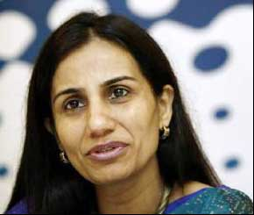
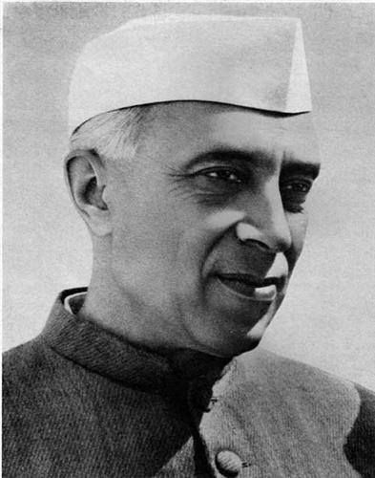
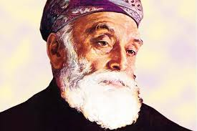
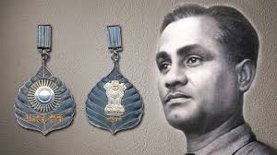
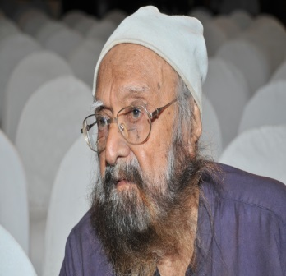
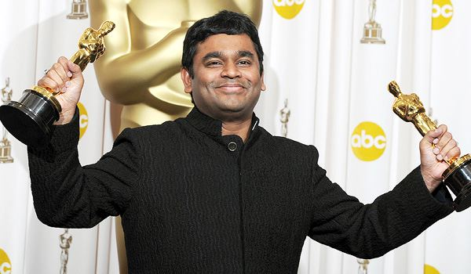
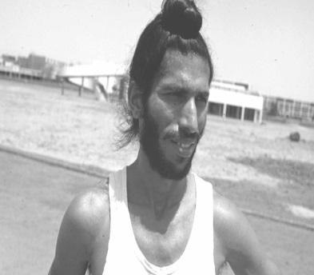
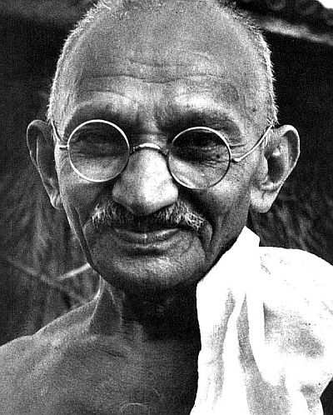
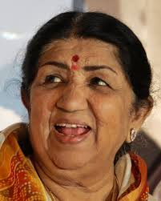
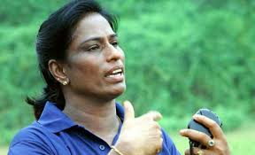
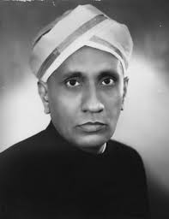
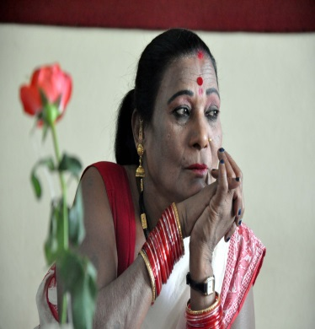
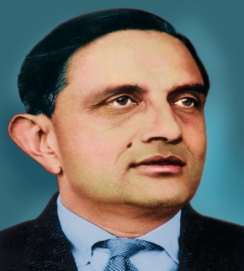
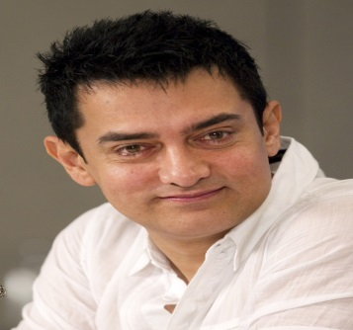
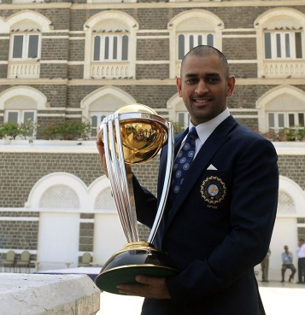
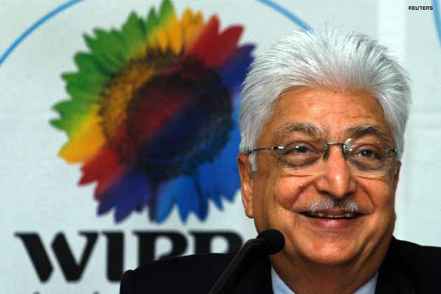
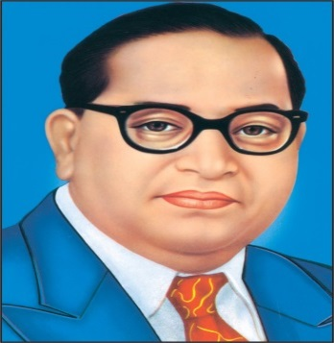
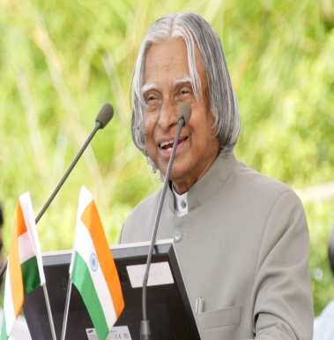
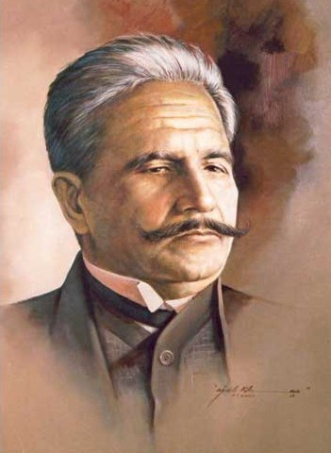
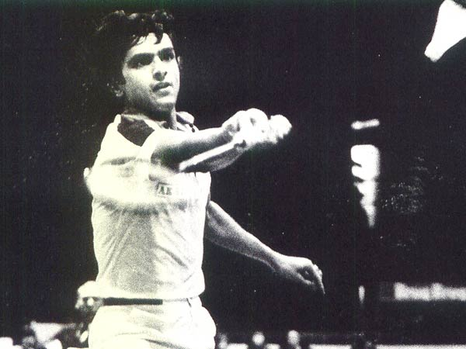
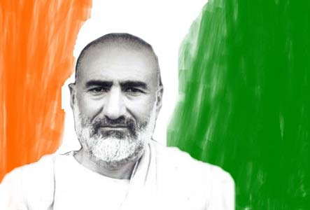
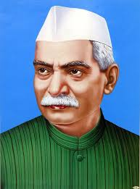
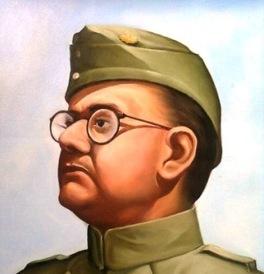

Slide 11
Ahimsa

Slide 12

Courage

Slide 13
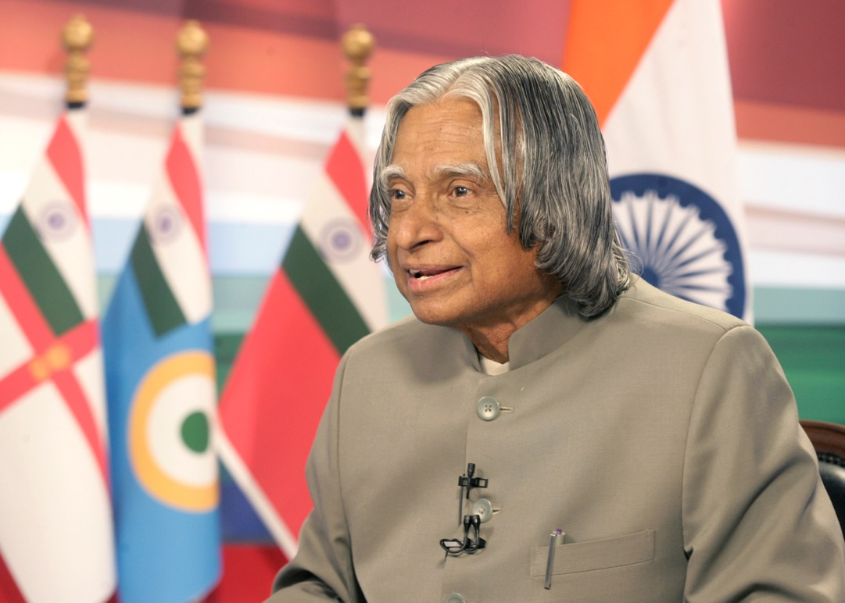
Vision

Slide 14

Social Engagement

Slide 15
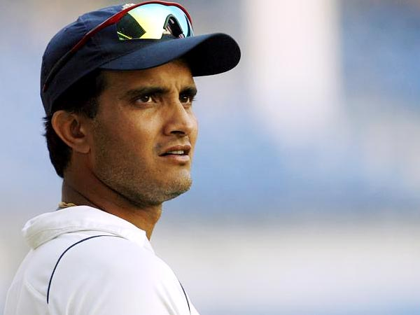
Perseverance

Slide 16
Values are many

Slide 17
Accountability
Achievement
Adaptability
Adventure
Authenticity
Authority
Autonomy
Balance
Beauty
Boldness
Challenge
Citizenship
Clarity of Thought
Commitment
Community
Compassion
Competency
Conformity
Contribution
Cooperation
Courage
Creativity
Curiosity
Decisiveness
Dedication
Determination
Dharma
Discipline
Ecological Awareness
Effectiveness
Efficiency
Empathy
Equality
Equity
Ethical Practice
Excellence
Fairness
Faith
Fame
Family
Fraternity
Friendships
Fun
Growth
Happiness
Hard work
Honesty
Humility
Humor
Independence
Influence
Initiative
Inner Harmony
Integrity
Justice
Kindness
Knowledge
Leadership
Learning
Liberty
Love
Loyalty
Meaningful Work
Objectivity
Openness
Optimism
Order
Peace
Perseverance
Personal Integrity
Pleasure
Poise
Popularity
Professional Integrity
Public service
Purity
Recognition
Religion
Reputation
Resilience
Respect
Responsibility
Secular
Security
Self-Respect
Service Orientation
Sincerity
Social Engagement
Spirituality
Stability
Status
Success
Tolerance
Transparency
Trustworthiness
Unity of the country
Vision
Wealth
Wisdom
Womanhood

Slide 18
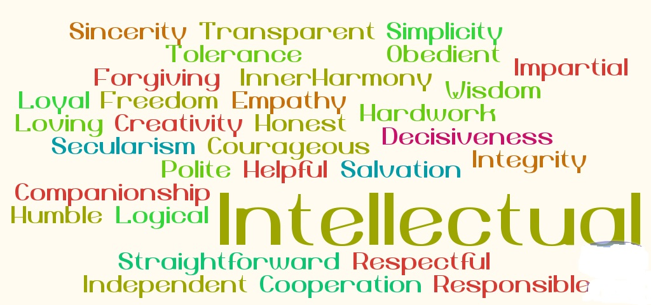

Slide 19
What are your Values?

Slide 20
Values (in priority order)
Professional Integrity; Equality & Justice; Vision (Future Oriented); Entrepreneurship; Calmness & Peace.

Slide 21
Value Dilemmas

Slide 22
Integrity = Alignment between espoused and lived values
Values refelcted in behaviour
Espoused values

Slide 23
Adaptation (Modifying according to context)
Integrity
(Value aligned with action)
Value Dilemma
Coherence
(Multiple values inside you)
Alignment
(Different people different value priorities)

Slide 24
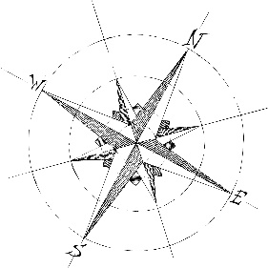
Adaptation
Congruence
Coherence
Alignment

Slide 25
There are three main questions that we should answer periodically:
  What are the core values that drive our life and work?
  How am I … living and working with “Value Dilemmas” now?
  How can I set a higher standard in the future?

Slide 26
Onion
Peels

Slide 27
Thank You
Concept & Design:
Mohan Dhamotharan, Ziaul Hoda & Ram Kumar Kakani

Slide 28
Values in the context of
Decision Making

